Slide 1
Assignment 2 - Int and String Lab –Step 2
Create a Console Application and then add a Windows Form class (or another Windows Forms Application).
Objective: the console provides options, user types one number to start a window form showing the selected result.
For example: Which city would like to live?
1. Toronto 2. Barrie 3. New York
Or a restaurant menu....
Office 2007 键盘快捷方式
Notes:
46

Slide 2
Assignment 2 - Int and String Lab
Requirements and instructions:
Initial codes would be provided.Please read the code and use them.
You should better to create new projects following the instructions:
Office 2007 键盘快捷方式

Slide 3
Assignment 2 - Int and String Lab
Add a Windows Form to the console application project(or Add a Windows Forms Application to the solution)Insert 3 Picturebox controls in the Windows Form in Design View(https://stackoverflow.com/questions/31016581/how-to-open-designer-view-in-visual-c).Import different pictures into the 3 picture boxes.
Switch to Code View and add/change the codes for only one function:Form1 (or same name as your form). The codes could be different with the sample codes
Office 2007 键盘快捷方式

Slide 4
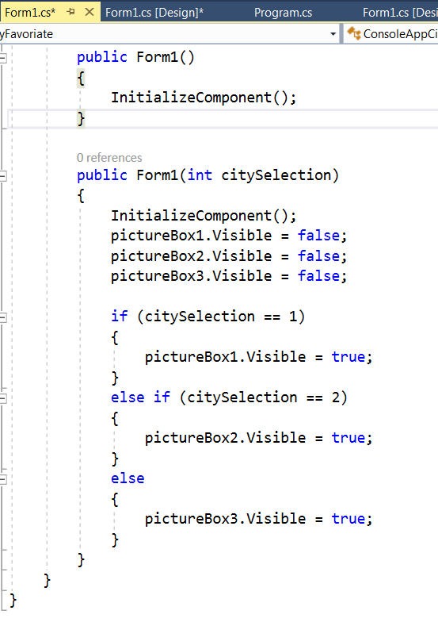
Sample codes for the Form1.cs

Slide 5
If you got some codes like the following, do not delete them. Just leave the method body blank.
If you delete, you may got errors.
private void Form1_Load(object sender, EventArgs e)
{
}

Slide 6
Create a Console Application
If you created a Windows forms application, you need to add a reference of the Windows forms application(project) and a reference of the assembly of System.Windows.Forms. to the Console app project
Change codes in program.cs in the console application, as following. Try to use the code analysis light bulb to fix the errors or google.

Slide 7
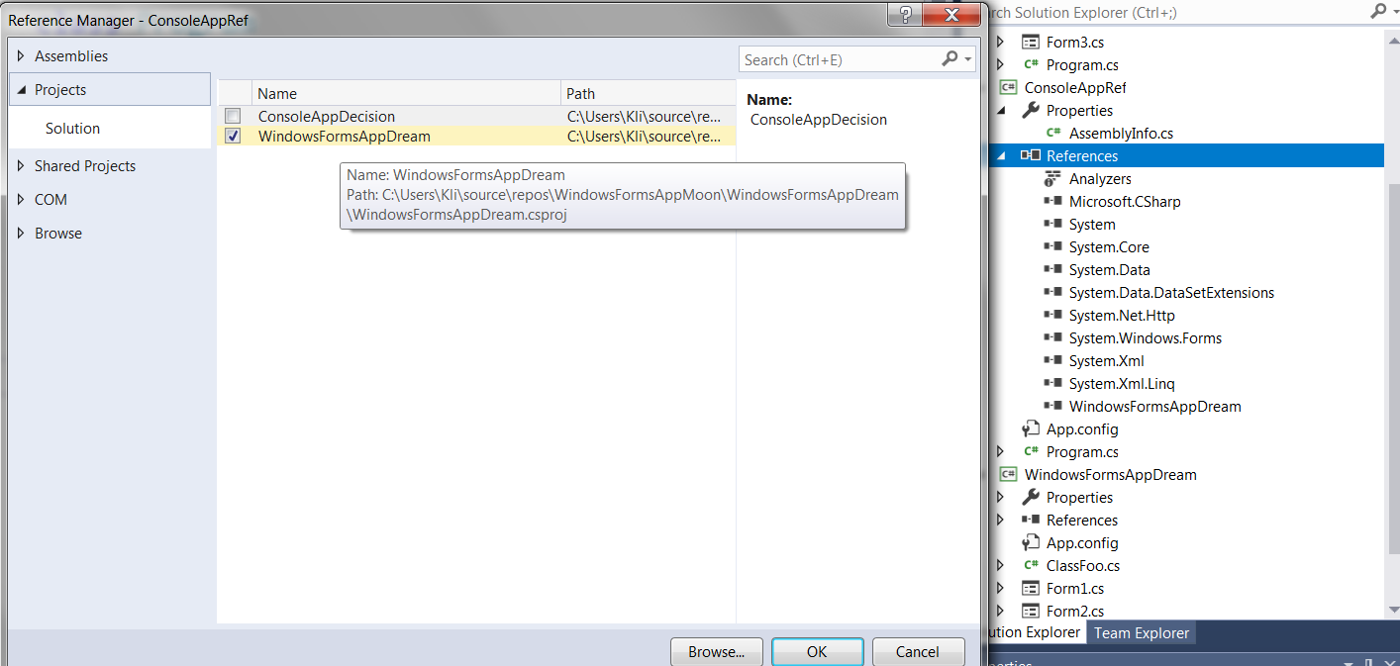
To add the reference to a project

Slide 8
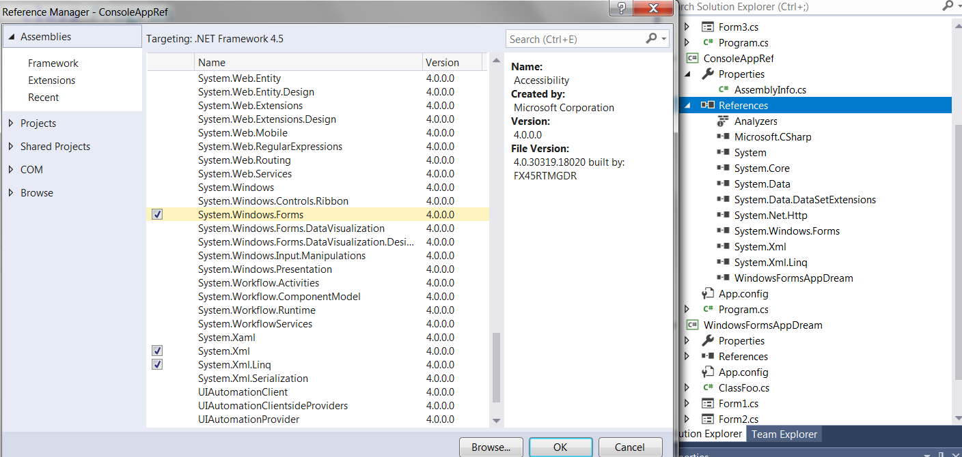

Slide 9
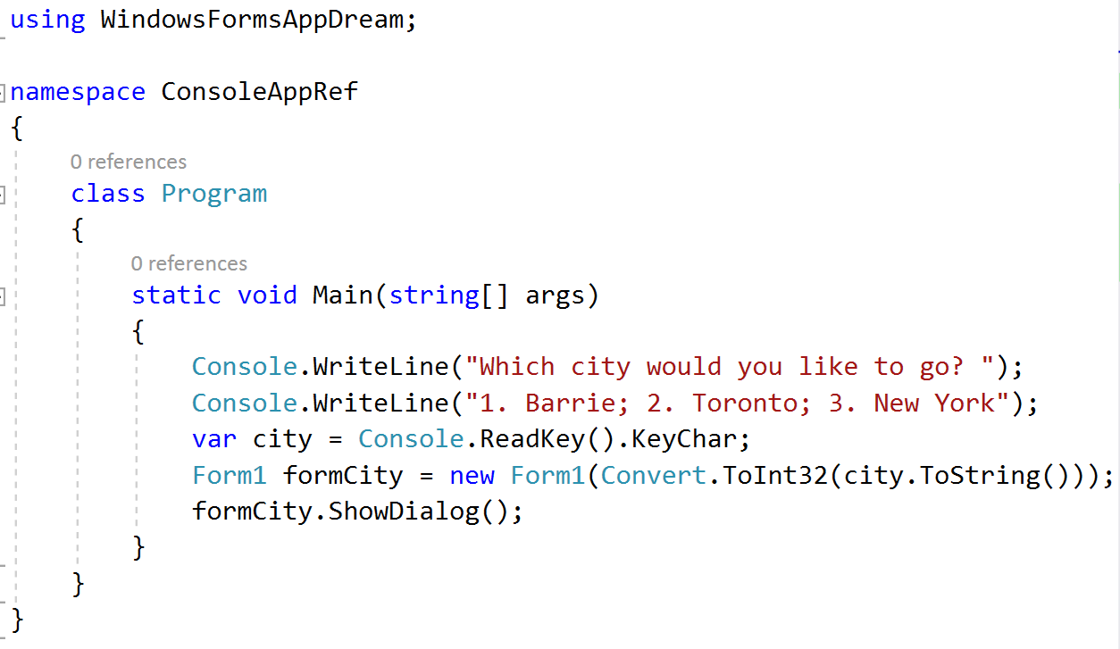
Sample codes for program.cs in the console app.

Slide 10
Assignment 2 - Int and String Lab
Submission:
If you can show me your app in the Q/A session, it would be great. Otherwise, please zip your project folders and upload to Blackboard website.

